Slide 1

Course Management System
Notes:
Hi Everyone,
Good Morning
Before we start with the presentation today, I would like to share a small recital.
We have been a part of Publicis Sapient for almost 3months now, and there is this fact that everyone of us would agree upon.
We all started as fresh graduates, underwent 5weeks or so of rigorous training followed by what…5 weeks now of a Hands On project, and what has transpired in these days is a fact that we all are really proud of. A transformation from someone who could code, to someone who can not only code, but add value to everything he does.
So have we succeeded at becoming a Product engineer?
Hi, I am Rajat, a small part of our big team here.
I am here with my colleagues Aman and Chinmay and we are here to give you a walkthrough of our Transformation, our Journey and the project we have been working for sometime now.

Slide 2
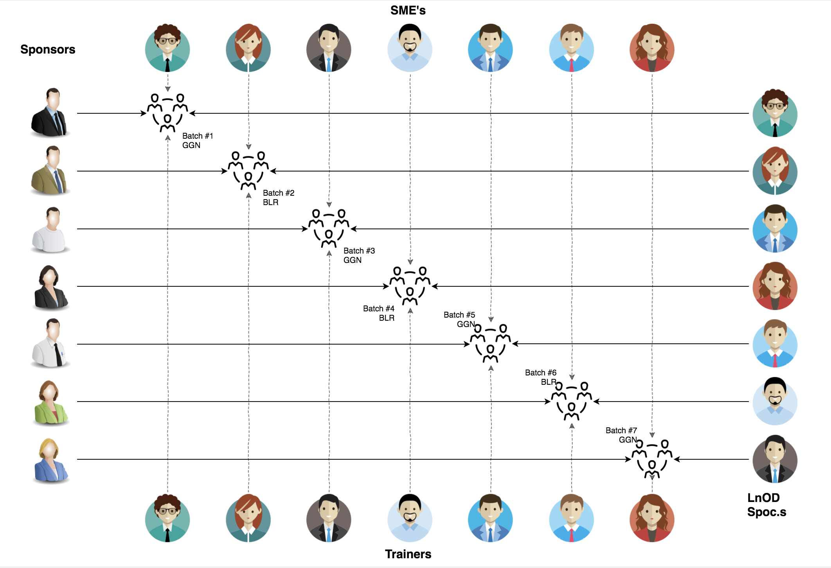
Stakeholders
Sponsors
Flipkart
SME’s
Deepika Gajraj
Sakshi (Order Trainings)
3. Trainers
Amit Balyan

Slide 3

Agenda
01
Our Journey
02
Our Team
03
Team Structure
04
Problem Statement
05
Engineering Practices
06
Tech Stack
07
Development
08
Challenges & Learnings
09
Demo
10
Questions
Notes:
Time – 1 min

Slide 4

Our Journey
Notes:
Time - 2 mins

Slide 5
ACTION PLAN
 | Modules | Description
Week 1 (Jan’11 - Jan’17) | UNIX GIT UML Diagrams | Understanding Unix and Git commands Requirement understanding and diagram design
Week 2 (Jan’18 - Jan’24) | Java 8 Exception Handling SQL | Developing a POS Application using Java and MySQL. Understanding Java 8 features and collections
Week 3 (Jan’25 - Feb’1) | Jersey and DropWizard | REST API Development using Jersey and DropWizard framework

Slide 6
Demo
Testing
Process
5
project Demo
Tools
4
Testing on Console, REST client such as Postman
Comprehend
3
Architecture Design and Development
2
Decide the Technology stack for console and REST API development
1
Understanding Project Requirements and Goals

Slide 7
Our next starts
NOW
Notes:
Time – 1 min
Swati

Slide 8
3 WEEKS OF TRAINING + PROJECT DEMO
16 DAYS
128 HOURS
7680 MINUTES
460,800 SECONDS
LIMITLESS KNOWLEDGE

Slide 9

Our Team
Notes:
Time – 2 mins

Slide 10
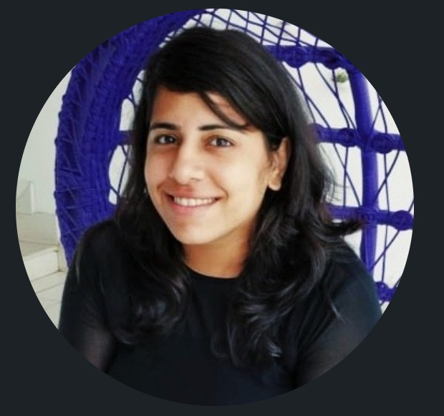
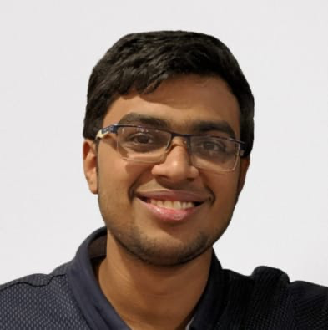
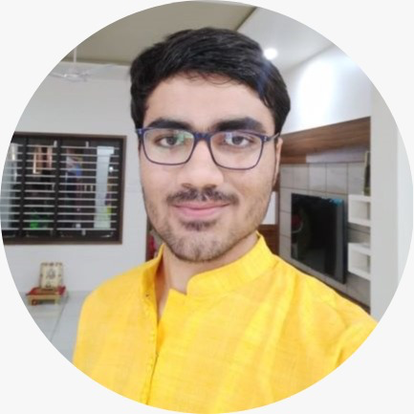
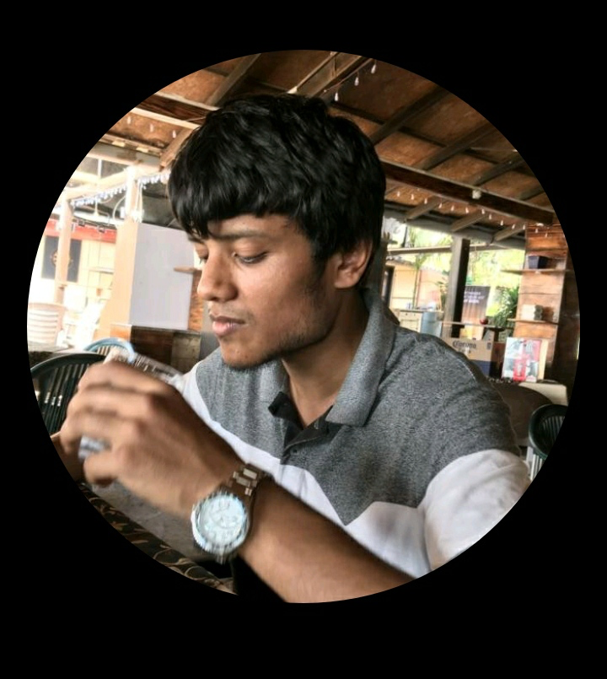
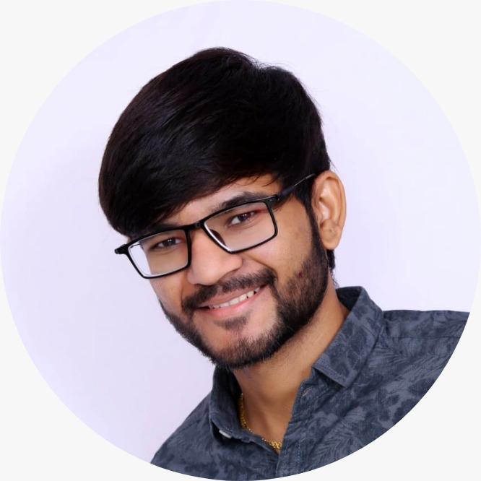
Dilpreet Kaur
Anurag Behera
Rag Patel
Lakshya Goyal
Umang Ughareja

Slide 11
Name | Responsibility
Dilpreet Kaur | Implemented Professor, User functionalities Use Case Diagrams
Lakshya Goyal | Implemented Student, User functionalities Sequence Diagrams
Umang Ughareja
Rag Patel | Implemented Admin functionalities Class Diagrams
Anurag Behera
Notes:
Name alongwith responsibilities

Slide 12

Project Goals
Notes:
Time – 3 mins

Slide 13




Problem Statement
To develop a POS application and REST API for Course Registration System using JAVA where the student can register, add/drop course, professors can view courses, enrolled students while admin can manage users, add/drop courses to catalog
1
2
Quality
Security
3
4
Interactivity
Speed
Notes:
User satisfaction and brand value
Problem Statement

Slide 14

Engineering Practices
Notes:
Time – 5 mins

Slide 15
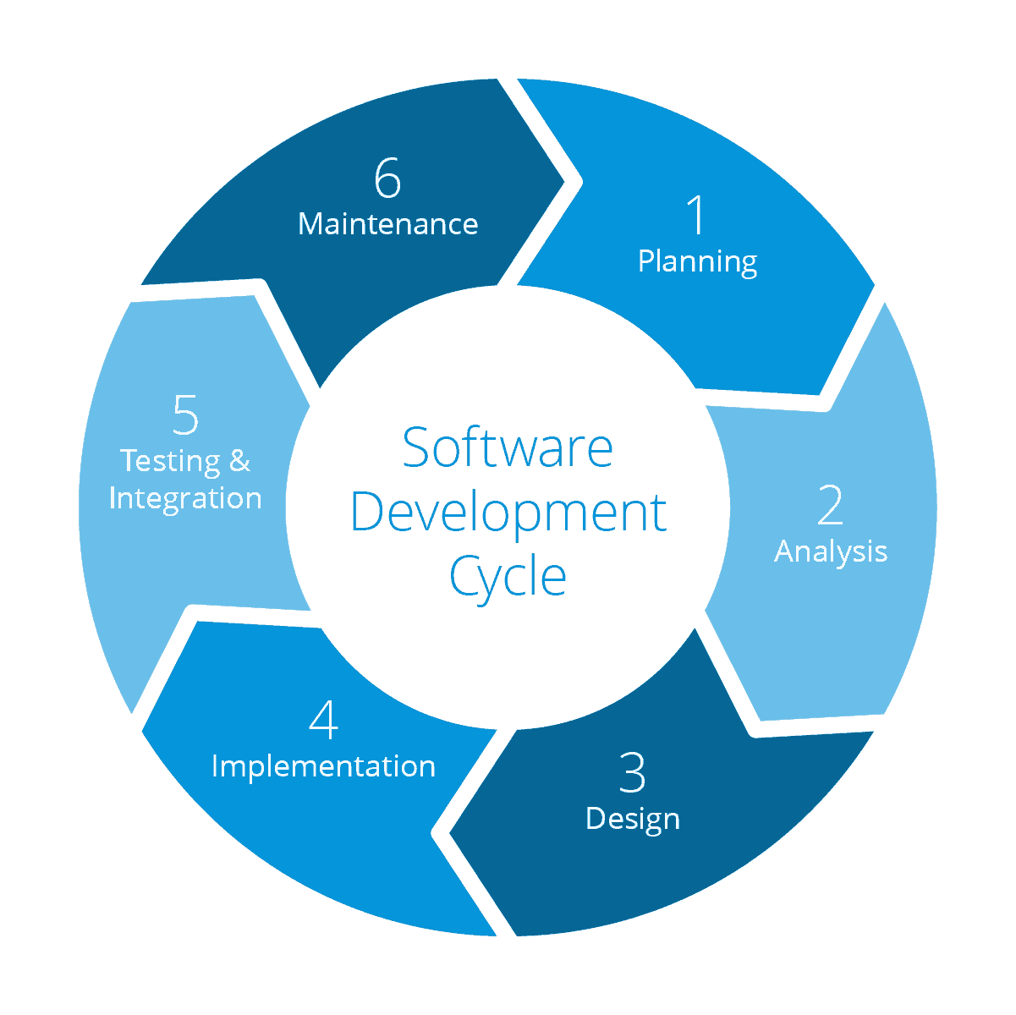
Requirement Gathering
Tech Stack Selection
UML Artifacts, Architecture Design
Code development
Notes:
Implementation ->

Slide 16

Tech Stack
Notes:
Time – 2 mins

Slide 17







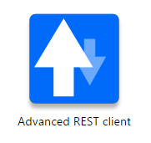









Designing
Backend
Testing
Data
SCM
UML
Core Language
Tools
SQL Database
Code Collaboration
Framework
Application Server
Notes:
Time – 1 min
Java
Maven
DropWizard
MySQL
Jersey
GitHub
Postman / ARC (Check it)
StarUML / Dia / Lucid Charts
List
Design
Backend
Testing
Tools

Slide 18

Challenges & Learnings
Notes:
Time – 2 mins

Slide 19
 | Challenges | Learning
Week 1 | Understanding the problem statement Collaboration issues such as merge conflicts in Git UML diagram conventions | UNIX Ubuntu Git commands UML Diagrams
Week 2 | Installation softwares on multiple environments POS application development using layered architecture | Java 8 Exception Handling SQL
Week 3 | Resolving jar and version dependencies Jersey validation Running Apache TomCat server | REST API development using Jersey and DropWizard Maven DropWizard

Slide 20
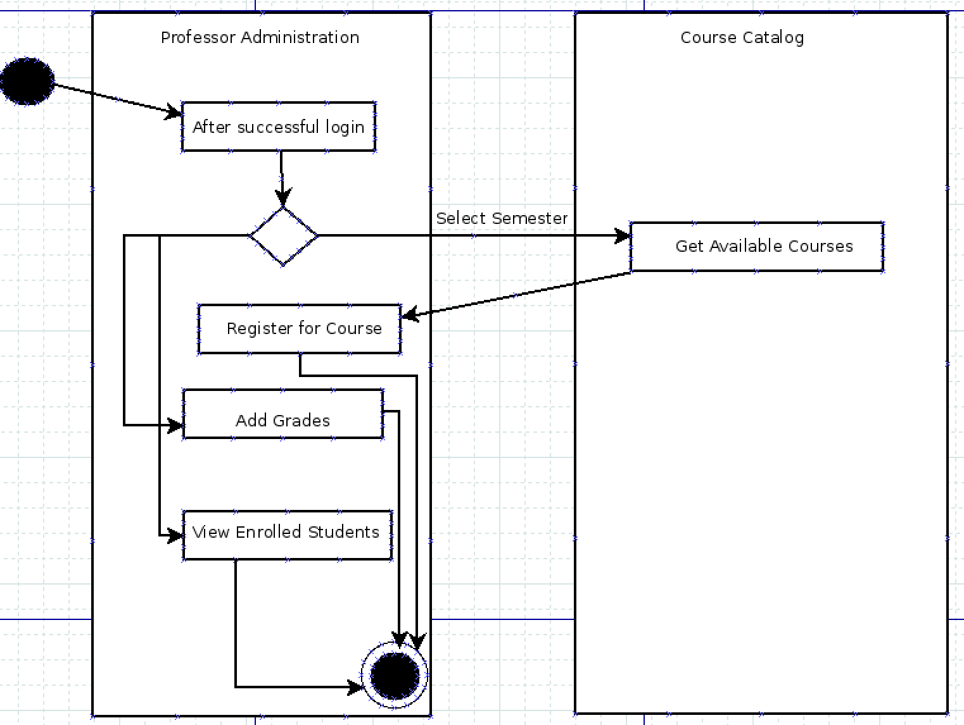
UML Diagrams

Slide 21

Architecture Design
Notes:
Time – 1 min

Slide 22

POS Application
Java Main Client
Business Code
Database Code
HTTP Request
HTTP Response
Notes:
n-tier

Slide 23

Demo
Notes:
Time –
Architecture – 5 mins
NFR Dashboard – 3 mins
Demo – 10 mins
1. Show the Responsiveness and Wave tool first

Slide 24

Questions
Notes:
Time - ?

Slide 25
Thank you
Notes:
Time – After this show the testimonial video. 1 min

